Slide 1
ME1020 Mechanical vibrations
Lecture 5
Base excitation

Slide 2
Objectives
Describe the characteristics of amplitude ratio and phase shift with respect to the frequency ratio
Analyze the response of 1DOF vibration system to base excitation including displacement transmission and force transmissivity
Apply the base excitation to seismic instruments using relative motion

Slide 3
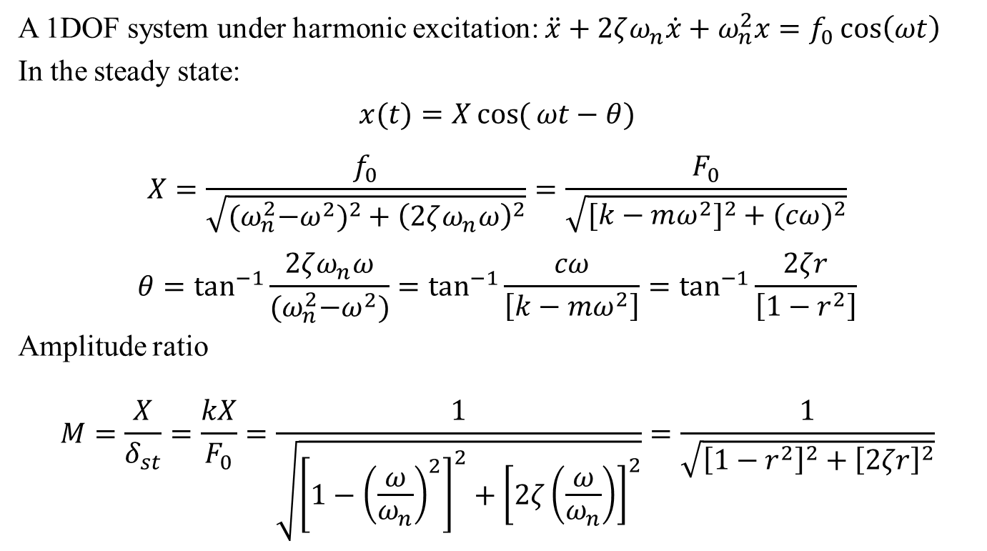
Steady state response
A 1DOF system under harmonic excitation: $\ddot{x}+2ζω_{n}\dot{x}+ω_{n}^{2}x=f_{0}\cos\left(ωt\right)$
In the steady state:
$$x(t)=X\cos{(}ωt−θ)$$
$$X=\frac{f_{0}}{\sqrt{{{(ω}_{n}^{2}−ω^{2})}^{2}+{\left(2ζω_{n}ω\right)}^{2}}}=\frac{F_{0}}{\sqrt{[k−mω^{2}]^{2}+(cω)^{2}}}$$
$$θ=\tan^{−1}{\frac{2ζω_{n}ω}{{(ω}_{n}^{2}−ω^{2})}}=\tan^{−1}{\frac{cω}{\left[k−mω^{2}\right]}}=\tan^{−1}{\frac{2ζr}{\left[1−r^{2}\right]}}$$
Amplitude ratio
$$M=\frac{X}{δ_{st}}=\frac{kX}{F_{0}}=\frac{1}{\sqrt{{\left[1−{\left(\frac{ω}{ω_{n}}\right)}^{2}\right]}^{2}+{\left[2ζ\left(\frac{ω}{ω_{n}}\right)\right]}^{2}}}=\frac{1}{\sqrt{{\left[1−r^{2}\right]}^{2}+{\left[2ζr\right]}^{2}}}$$

Slide 4
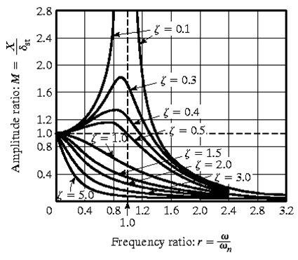
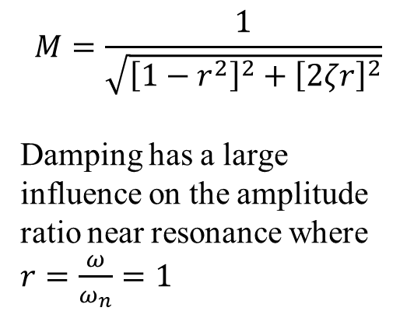
Amplitude ratio
$$M=\frac{1}{\sqrt{{\left[1−r^{2}\right]}^{2}+{\left[2ζr\right]}^{2}}}$$
Damping has a large influence on the amplitude ratio near resonance where $r=\frac{ω}{ω_{n}}=1$

Slide 5
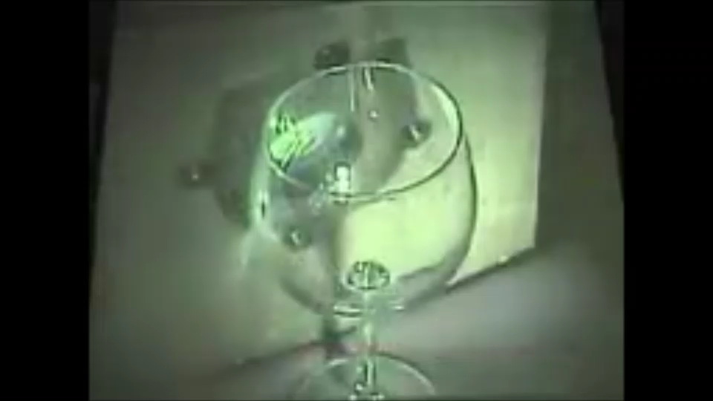
Resonance

Slide 6
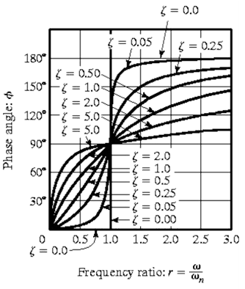
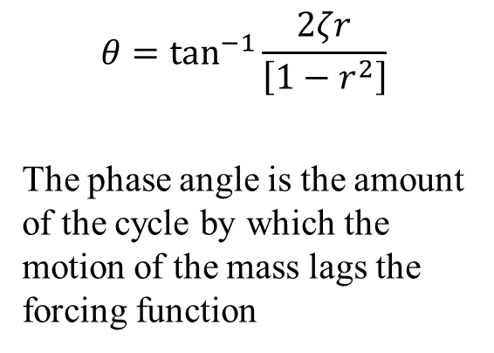
Phase shift
$$θ=\tan^{−1}{\frac{2ζr}{\left[1−r^{2}\right]}}$$
The phase angle is the amount of the cycle by which the motion of the mass lags the forcing function

Slide 7
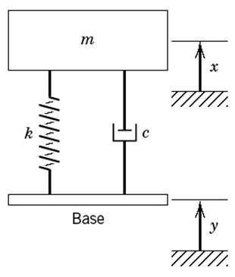
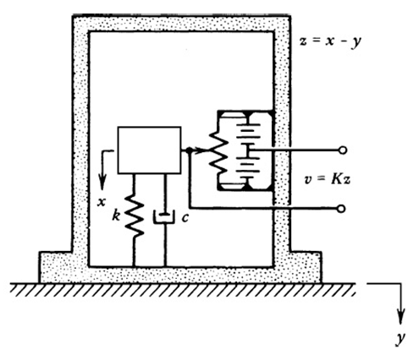
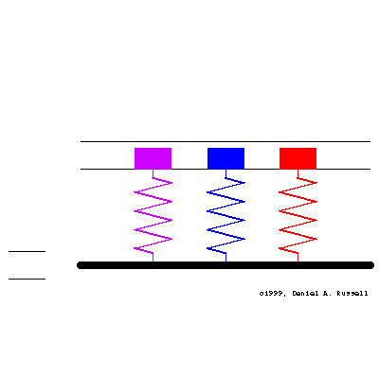
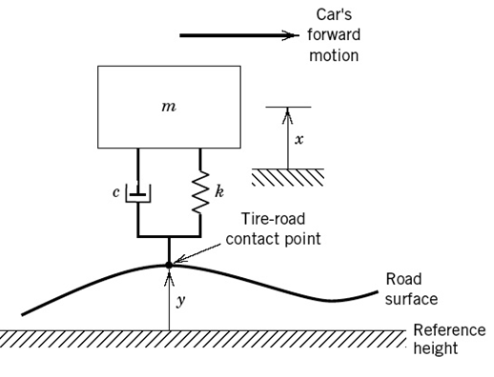
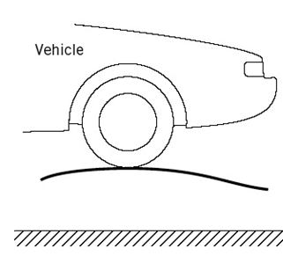
Base excitation examples
Seismic instruments
Car suspension

Slide 8
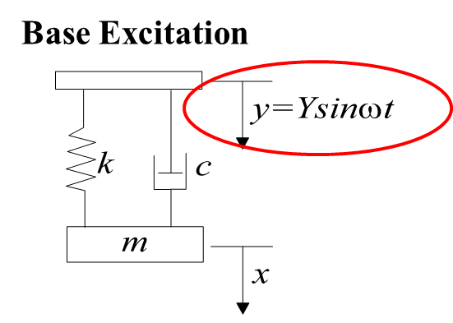
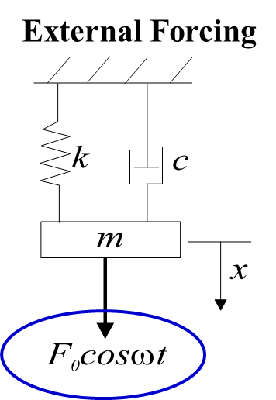
Base vs force excitation

Slide 9
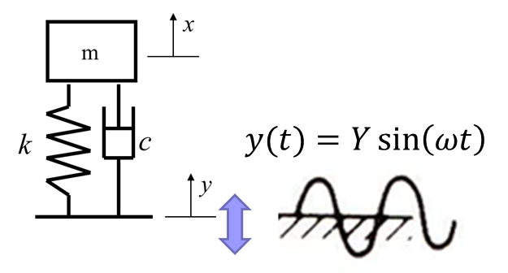
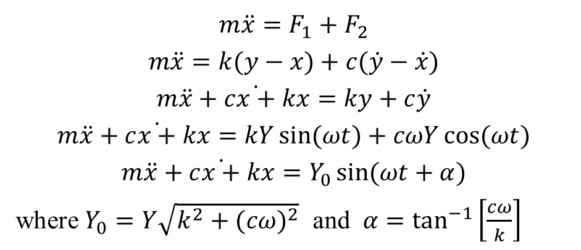
Equation of motion
Free-body diagram:
m
x(t)
F₁
F₂
x(t)
k
c
y(t)
$${m\ddot{x}=F}_{1}+F_{2}$$
$$m\ddot{x}=k(y−x)+c(\dot{y}−\dot{x})$$
$$m\ddot{x}+c\dot{x+}kx=ky+c\dot{y}$$
$$m\ddot{x}+c\dot{x+}kx=kY\sin{(ωt)}+cωY\cos{(ωt})$$
$$m\ddot{x}+c\dot{x+}kx=Y_{0}\sin{(ωt+α)}$$
where $Y_{0}=Y\sqrt{k^{2}+(cω)^{2}} \text{and} α=\tan^{−1}\left[\frac{cω}{k}\right]$
F₁
F₂
y

Slide 10
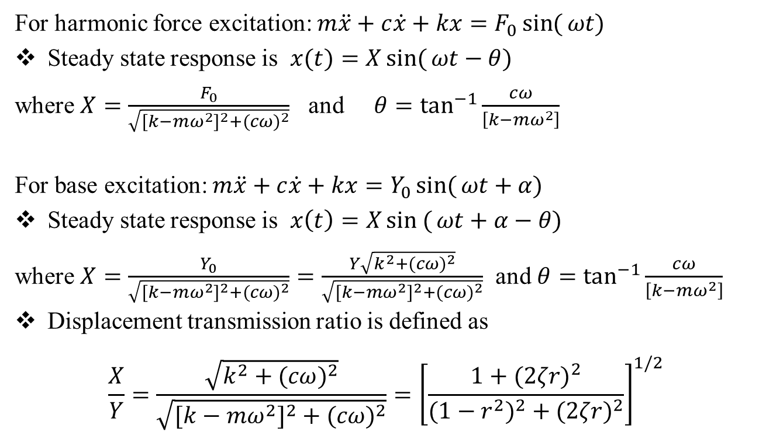
Steady state response
For harmonic force excitation: $m\ddot{x}+c\dot{x}+kx=F_{0}\sin{(}ωt)$
Steady state response is $x(t)=X\sin{(}ωt−θ)$
where $X=\frac{F_{0}}{\sqrt{[k−mω^{2}]^{2}+(cω)^{2}}}$ and $θ=\tan^{−1}{\frac{cω}{\left[k−mω^{2}\right]}}$
For base excitation: $m\ddot{x}+c\dot{x}+kx=Y_{0}\sin{(}ωt+α)$
Steady state response is $x\left(t\right)=X\sin{(}ωt+α−θ)$
where $X=\frac{Y_{0}}{\sqrt{[k−mω^{2}]^{2}+(cω)^{2}}}=\frac{Y\sqrt{k^{2}+(cω)^{2}}}{\sqrt{[k−mω^{2}]^{2}+(cω)^{2}}}$ and $θ=\tan^{−1}{\frac{cω}{\left[k−mω^{2}\right]}}$
Displacement transmission ratio is defined as
$$\frac{X}{Y}=\frac{\sqrt{k^{2}+(cω)^{2}}}{\sqrt{[k−mω^{2}]^{2}+(cω)^{2}}}={\left[\frac{1+(2ζr)^{2}}{(1−r^{2})^{2}+(2ζr)^{2}}\right]}^{1/2}$$

Slide 11
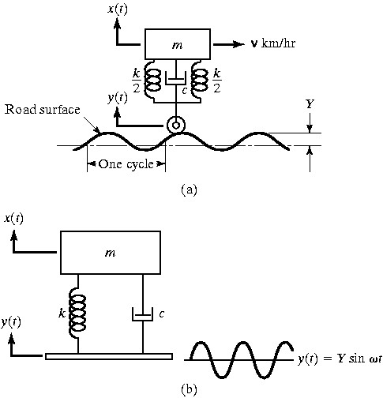
Example 1
The figure below shows a simple model of a motor vehicle that can vibrate in the vertical direction while traveling over a rough road. The vehicle has a mass of 1200 kg. The suspension system has a spring constant of 400 kN/m and a damping ratio of ζ = 0.5. If the vehicle speed is 20 km/hr, determine the displacement amplitude of the vehicle. The road surface varies sinusoidally with an amplitude of Y = 0.05m and a wavelength of 6m.

Slide 12
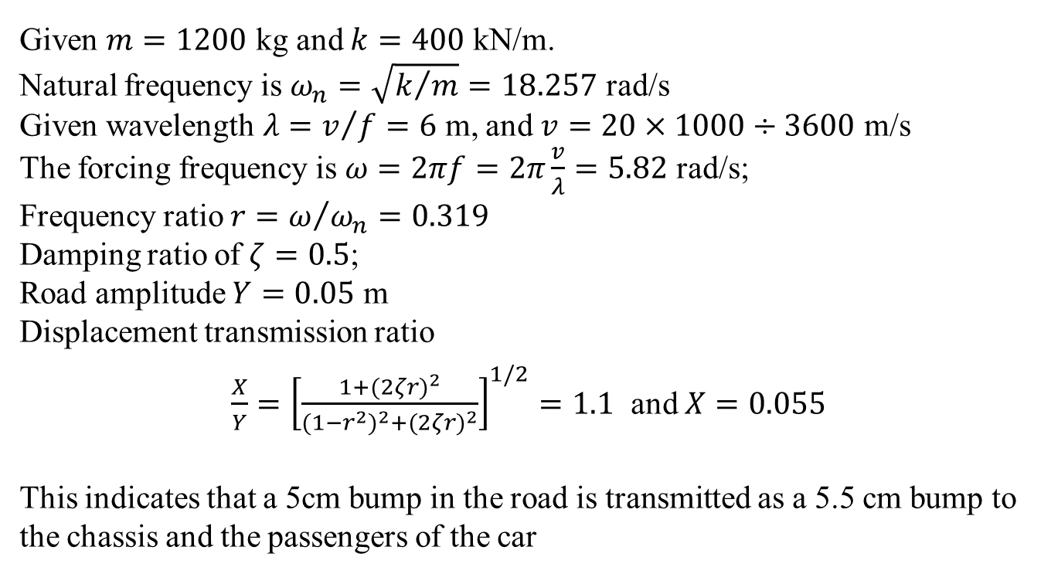
Example 1
Given $m=1200$ kg and $k=400$ kN/m.
Natural frequency is $ω_{n}=\sqrt{k/m}=18.257$ rad/s
Given wavelength $λ=v/{f=6}$ m, and $v=20×1000÷3600$ m/s
The forcing frequency is $ω=2πf=2π\frac{v}{λ}=5.82$ rad/s;
Frequency ratio $r=ω/{ω_{n}=0.319}$
Damping ratio of $ζ=0.5$;
Road amplitude $Y=0.05$ m
Displacement transmission ratio
$\frac{X}{Y}={\left[\frac{1+(2ζr)^{2}}{(1−r^{2})^{2}+(2ζr)^{2}}\right]}^{1/2}=1.1$ and $X=0.055$
This indicates that a 5cm bump in the road is transmitted as a 5.5 cm bump to the chassis and the passengers of the car

Slide 13
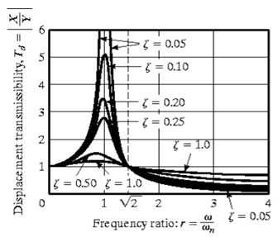
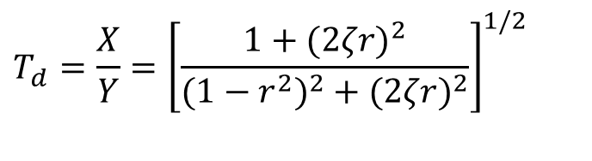
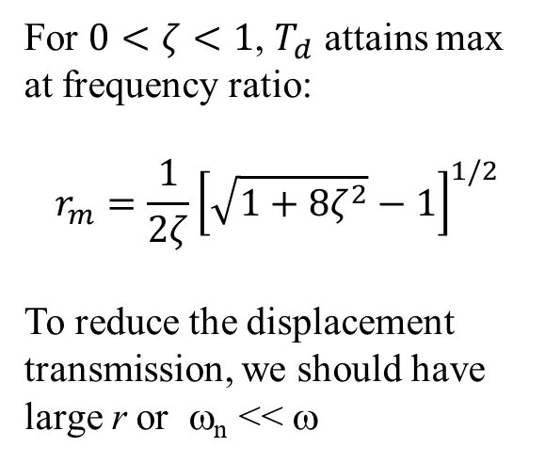
Displacement transmissibility
$$T_{d}=\frac{X}{Y}={\left[\frac{1+(2ζr)^{2}}{(1−r^{2})^{2}+(2ζr)^{2}}\right]}^{1/2}$$
For $0<ζ<1$, $T_{d}$ attains max at frequency ratio:
$$r_{m}=\frac{1}{2ζ}{\left[\sqrt{1+8ζ^{2}}−1\right]}^{1/2}$$
To reduce the displacement transmission, we should have large r or ω_{n} << ω

Slide 14
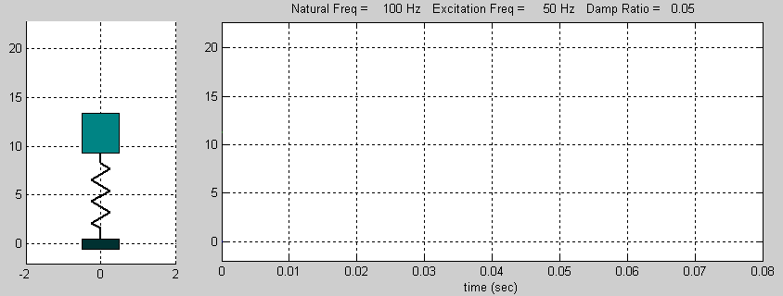
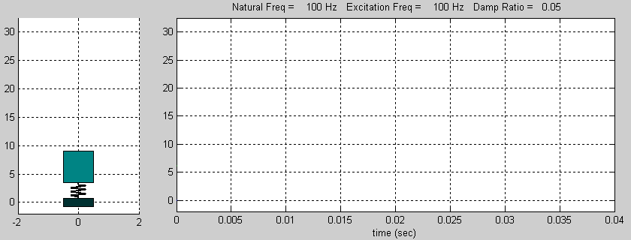
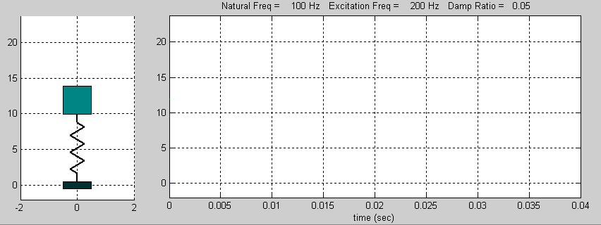
Displacement transmission
Natural frequency = 100 Hz
Excitation frequency = 50 Hz
Damping ratio = 0.05
Natural frequency = 100 Hz
Excitation frequency = 100 Hz
Damping ratio = 0.05
Natural frequency = 100 Hz
Excitation frequency = 200 Hz
Damping ratio = 0.05

Slide 15
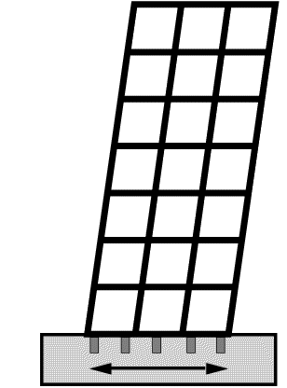
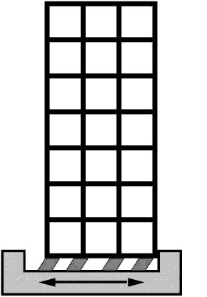
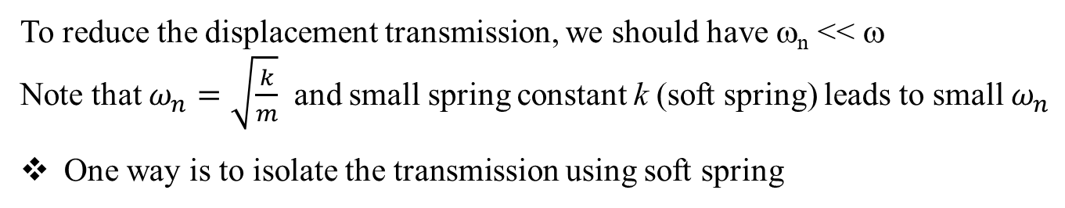
Displacement transmissibility
To reduce the displacement transmission, we should have ω_{n} << ω
Note that $ω_{n}=\sqrt{\frac{k}{m}}$ and small spring constant k (soft spring) leads to small $ω_{n}$
One way is to isolate the transmission using soft spring
Non-isolated
Isolated
“soft” spring

Slide 16
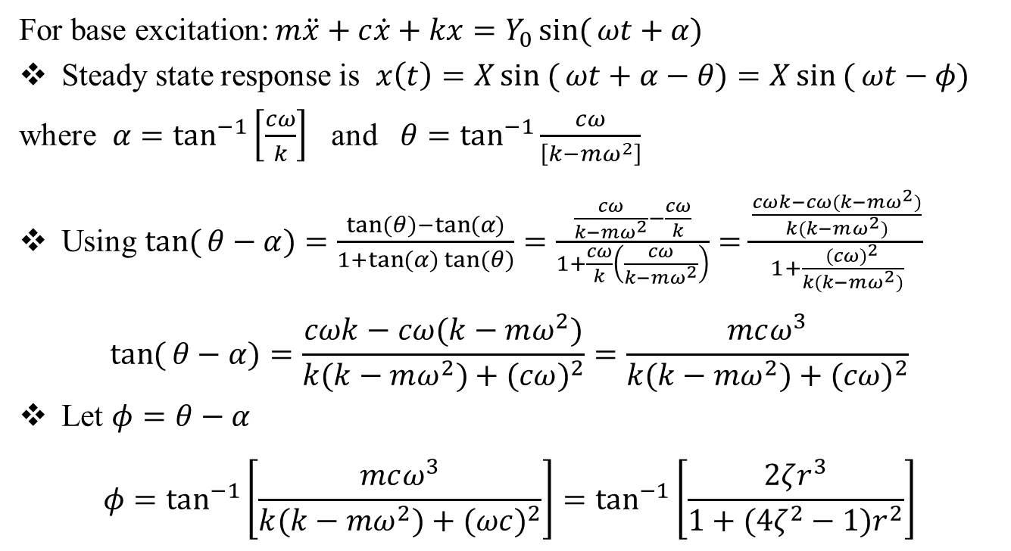
Phase shift
For base excitation: $m\ddot{x}+c\dot{x}+kx=Y_{0}\sin{(}ωt+α)$
Steady state response is $x\left(t\right)=X\sin{(}ωt+α−θ)=X\sin{(}ωt−φ)$
where $α=\tan^{−1}\left[\frac{cω}{k}\right]$ and $θ=\tan^{−1}{\frac{cω}{\left[k−mω^{2}\right]}}$
Using $\tan{(}θ−α)=\frac{\tan{(}θ)−\tan{(}α)}{1+\tan{(}α)\tan{(}θ)}=\frac{\frac{cω}{k−mω^{2}}−\frac{cω}{k}}{1+\frac{cω}{k}\left(\frac{cω}{k−mω^{2}}\right)}=\frac{\frac{cωk−cω(k−mω^{2})}{k(k−mω^{2})}}{1+\frac{(cω)^{2}}{k(k−mω^{2})}}$
$$\tan{(}θ−α)=\frac{cωk−cω(k−mω^{2})}{k(k−mω^{2})+(cω)^{2}}=\frac{mcω^{3}}{k(k−mω^{2})+(cω)^{2}}$$
Let $φ=θ−α$
$$φ=\tan^{−1}\left[\frac{mcω^{3}}{k(k−mω^{2})+(ωc)^{2}}\right]=\tan^{−1}\left[\frac{2ζr^{3}}{1+(4ζ^{2}−1)r^{2}}\right]$$

Slide 17
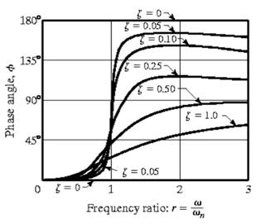
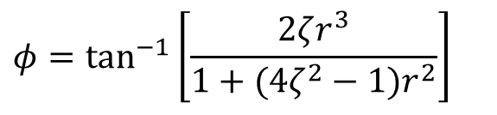
Phase shift
$$φ=\tan^{−1}\left[\frac{2ζr^{3}}{1+(4ζ^{2}−1)r^{2}}\right]$$

Slide 18
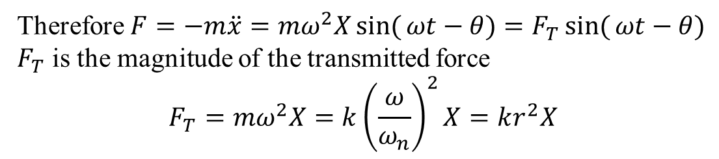
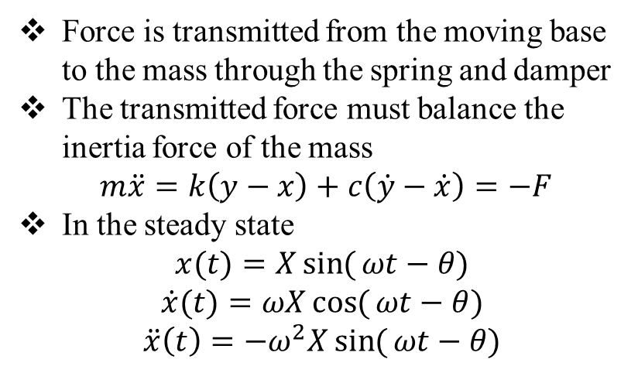
Force transmitted
Force is transmitted from the moving base to the mass through the spring and damper
The transmitted force must balance the inertia force of the mass
$m\ddot{x}=k\left(y−x\right)+c\left(\dot{y}−\dot{x}\right)=−F$
In the steady state
$$x(t)=X\sin{(}ωt−θ)$$
$$\dot{x}(t)=ωX\cos{(}ωt−θ)$$
$$\ddot{x}\left(t\right)=−ω^{2}X\sin{(}ωt−θ)$$
x(t)
m
F_{T}
k
c
y(t)
base
Therefore $F=−m\ddot{x}={mω}^{2}X\sin{(}ωt−θ)=F_{T}\sin{(}ωt−θ)$
$F_{T}$ is the magnitude of the transmitted force
$$F_{T}={mω}^{2}X=k{\left(\frac{ω}{ω_{n}}\right)}^{2}X=kr^{2}X$$

Slide 19
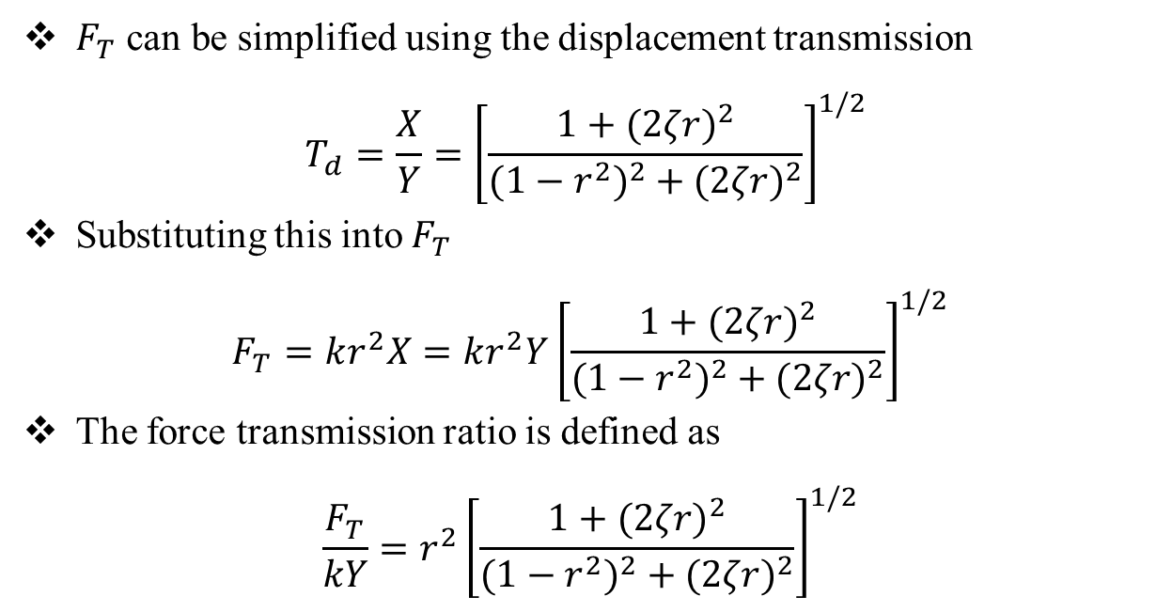
Force transmitted
$F_{T}$ can be simplified using the displacement transmission
$$T_{d}=\frac{X}{Y}={\left[\frac{1+(2ζr)^{2}}{(1−r^{2})^{2}+(2ζr)^{2}}\right]}^{1/2}$$
Substituting this into $F_{T}$
$$F_{T}=kr^{2}X=kr^{2}Y{\left[\frac{1+(2ζr)^{2}}{(1−r^{2})^{2}+(2ζr)^{2}}\right]}^{1/2}$$
The force transmission ratio is defined as
$$\frac{F_{T}}{kY}=r^{2}{\left[\frac{1+(2ζr)^{2}}{(1−r^{2})^{2}+(2ζr)^{2}}\right]}^{1/2}$$

Slide 20
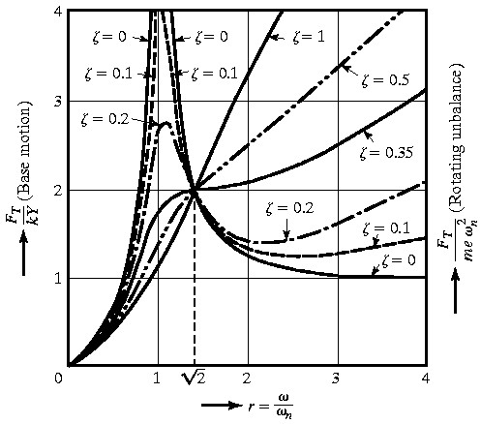
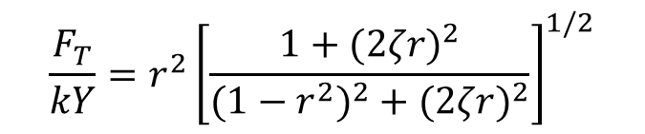
Force transmissibility
$$\frac{F_{T}}{kY}=r^{2}{\left[\frac{1+(2ζr)^{2}}{(1−r^{2})^{2}+(2ζr)^{2}}\right]}^{1/2}$$

Slide 21
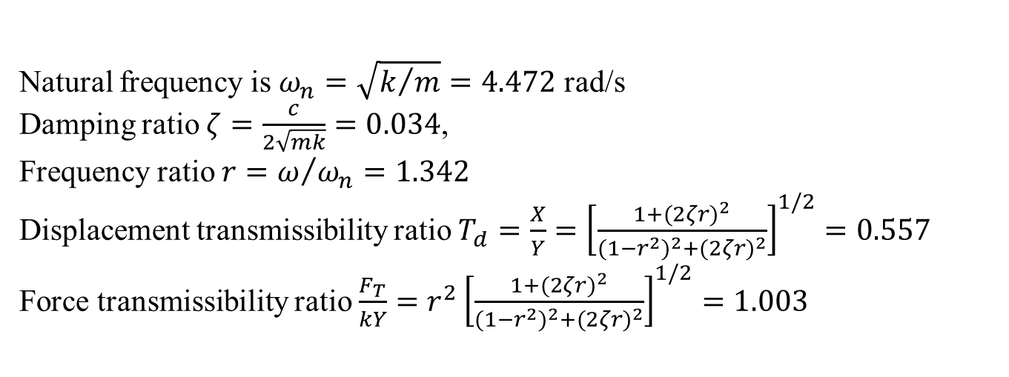
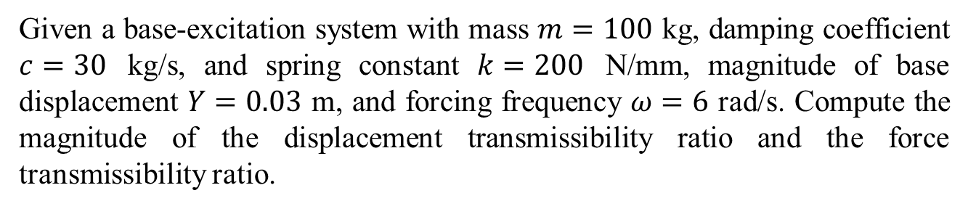
Example 2
Given a base-excitation system with mass $m=100$ kg, damping coefficient $c=30$ kg/s, and spring constant $k=200$ N/mm, magnitude of base displacement $Y=0.03$ m, and forcing frequency $ω=6$ rad/s. Compute the magnitude of the displacement transmissibility ratio and the force transmissibility ratio.
Natural frequency is $ω_{n}=\sqrt{k/m}=4.472$ rad/s
Damping ratio $ζ=\frac{c}{2\sqrt{mk}}=0.034$,
Frequency ratio $r=ω/{ω_{n}=1.342}$
Displacement transmissibility ratio $T_{d}=\frac{X}{Y}={\left[\frac{1+(2ζr)^{2}}{(1−r^{2})^{2}+(2ζr)^{2}}\right]}^{1/2}=0.557$
Force transmissibility ratio $\frac{F_{T}}{kY}=r^{2}{\left[\frac{1+(2ζr)^{2}}{(1−r^{2})^{2}+(2ζr)^{2}}\right]}^{1/2}=1.003$

Slide 22
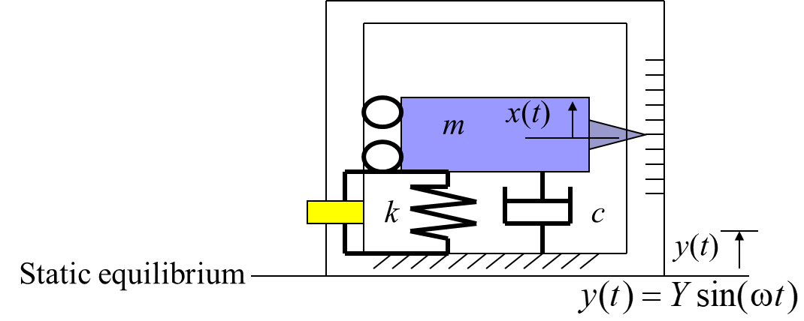
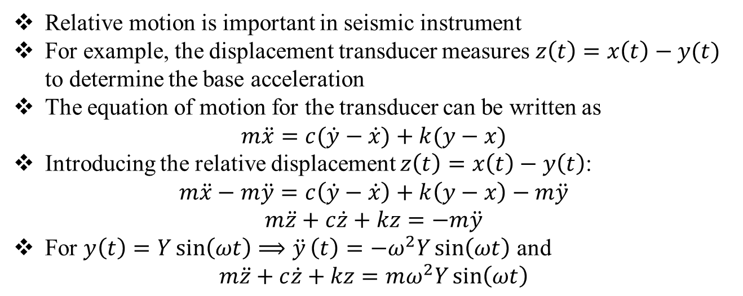
Relative motion
Relative motion is important in seismic instrument
For example, the displacement transducer measures $z\left(t\right)=x\left(t\right)−y(t)$ to determine the base acceleration
The equation of motion for the transducer can be written as
$$m\ddot{x}=c(\dot{y}−\dot{x})+k(y−x)$$
Introducing the relative displacement $z\left(t\right)=x\left(t\right)−y\left(t\right)$:
$$m\ddot{x}−m\ddot{y}=c\left(\dot{y}−\dot{x}\right)+k\left(y−x\right)−m\ddot{y}$$
$$m\ddot{z}+c\dot{z}+kz=−m\ddot{y}$$
For $y\left(t\right)=Y\sin\left(ωt\right)⟹\ddot{y}\left(t\right)=−ω^{2}Y\sin\left(ωt\right)$ and
$$m\ddot{z}+c\dot{z}+kz=mω^{2}Y\sin\left(ωt\right)$$

Slide 23
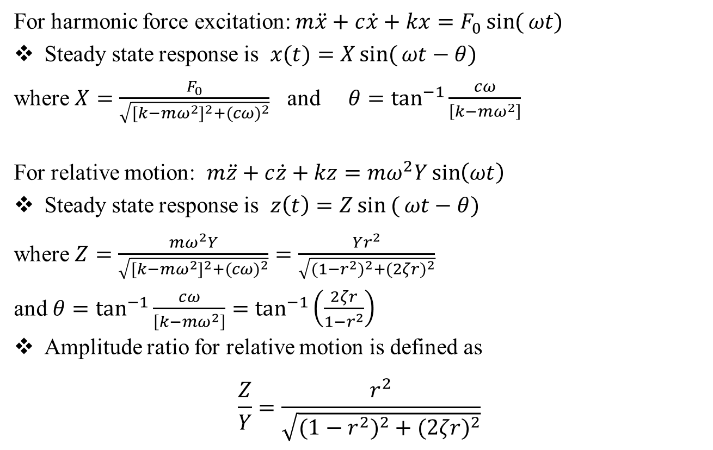
Relative motion
For harmonic force excitation: $m\ddot{x}+c\dot{x}+kx=F_{0}\sin{(}ωt)$
Steady state response is $x(t)=X\sin{(}ωt−θ)$
where $X=\frac{F_{0}}{\sqrt{[k−mω^{2}]^{2}+(cω)^{2}}}$ and $θ=\tan^{−1}{\frac{cω}{\left[k−mω^{2}\right]}}$
For relative motion: $m\ddot{z}+c\dot{z}+kz={mω}^{2}Y\sin\left(ωt\right)$
Steady state response is $z\left(t\right)=Z\sin{(}ωt−θ)$
where $Z=\frac{mω^{2}Y}{\sqrt{[k−mω^{2}]^{2}+(cω)^{2}}}=\frac{Yr^{2}}{\sqrt{(1−r^{2})^{2}+(2ζr)^{2}}}$
and $θ=\tan^{−1}{\frac{cω}{\left[k−mω^{2}\right]}}=\tan^{−1}\left(\frac{2ζr}{1−r^{2}}\right)$
Amplitude ratio for relative motion is defined as
$$\frac{Z}{Y}=\frac{r^{2}}{\sqrt{(1−r^{2})^{2}+(2ζr)^{2}}}$$

Slide 24
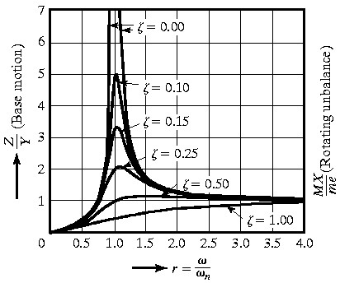

Relative motion
$$\frac{Z}{Y}=\frac{r^{2}}{\sqrt{(1−r^{2})^{2}+(2ζr)^{2}}}$$
Low frequencies: relative motion approaches zero
High frequencies: relative motion approaches 1

Slide 25
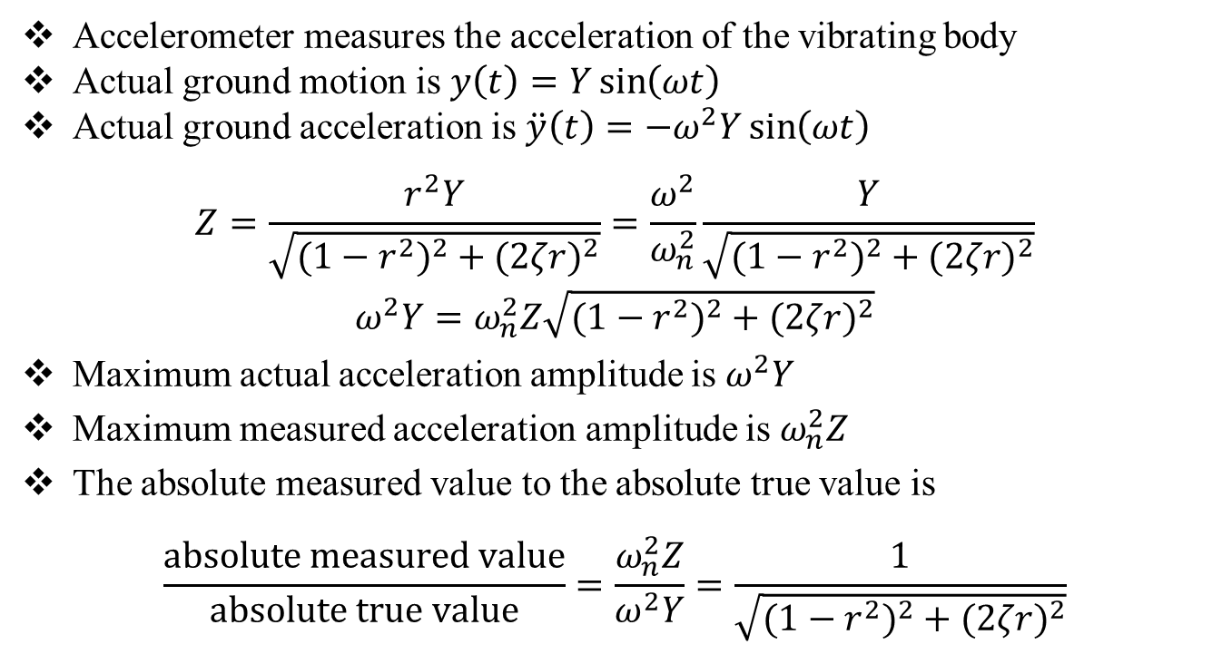
Accelerometer
Accelerometer measures the acceleration of the vibrating body
Actual ground motion is $y\left(t\right)=Y\sin\left(ωt\right)$
Actual ground acceleration is $\ddot{y}\left(t\right)=−ω^{2}Y\sin\left(ωt\right)$
$$Z=\frac{r^{2}Y}{\sqrt{(1−r^{2})^{2}+(2ζr)^{2}}}=\frac{ω^{2}}{ω_{n}^{2}}\frac{Y}{\sqrt{(1−r^{2})^{2}+(2ζr)^{2}}}$$
$$ω^{2}Y=ω_{n}^{2}Z\sqrt{(1−r^{2})^{2}+(2ζr)^{2}}$$
Maximum actual acceleration amplitude is $ω^{2}Y$
Maximum measured acceleration amplitude is $ω_{n}^{2}Z$
The absolute measured value to the absolute true value is
$$\frac{absolute measured value}{absolute true value}=\frac{ω_{n}^{2}Z}{ω^{2}Y}=\frac{1}{\sqrt{(1−r^{2})^{2}+(2ζr)^{2}}}$$

Slide 26
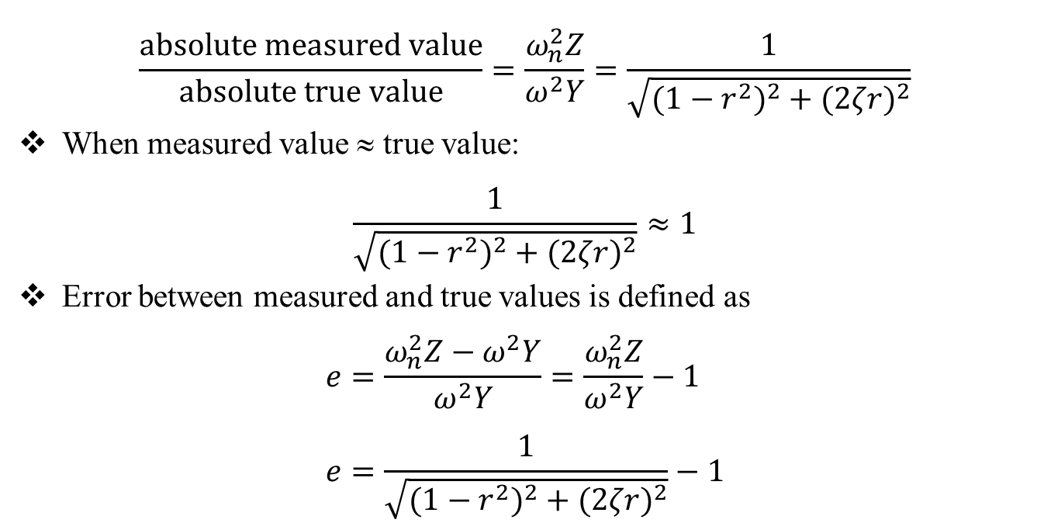
Accelerometer
$$\frac{absolute measured value}{absolute true value}=\frac{ω_{n}^{2}Z}{ω^{2}Y}=\frac{1}{\sqrt{(1−r^{2})^{2}+(2ζr)^{2}}}$$
When measured value ≈ true value:
$$\frac{1}{\sqrt{(1−r^{2})^{2}+(2ζr)^{2}}}≈1$$
Error between measured and true values is defined as
$$e=\frac{ω_{n}^{2}Z−ω^{2}Y}{ω^{2}Y}=\frac{ω_{n}^{2}Z}{ω^{2}Y}−1 \\ e=\frac{1}{\sqrt{(1−r^{2})^{2}+(2ζr)^{2}}}−1$$

Slide 27
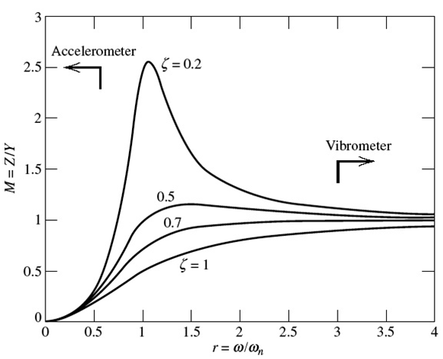
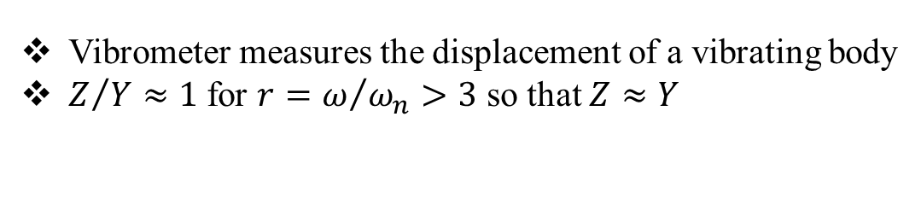
Vibrometer
Vibrometer measures the displacement of a vibrating body
$Z/{Y≈1}$ for $r=ω/{ω_{n}>3}$ so that $Z≈Y$

Slide 28
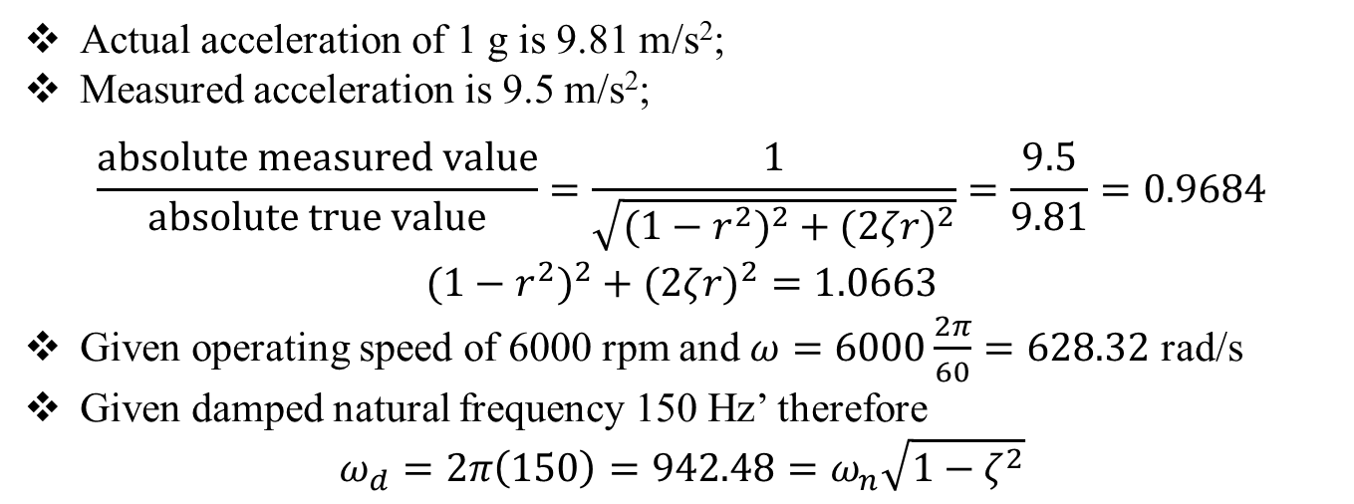
Example 3
An accelerometer has a suspended mass of 0.01 kg with a damped natural frequency of vibration of 150 Hz. When mounted on an engine undergoing an acceleration of 1g at an operating speed of 6000 rpm, the acceleration is recorded as 9.5 m/s² by the instrument. Find the damping constant and
the spring stiffness of the accelerometer
Actual acceleration of 1 g is 9.81 m/s²;
Measured acceleration is 9.5 m/s²;
$$\frac{absolute measured value}{absolute true value}=\frac{1}{\sqrt{(1−r^{2})^{2}+(2ζr)^{2}}}=\frac{9.5}{9.81}=0.9684$$
$$(1−r^{2})^{2}+(2ζr)^{2}=1.0663$$
Given operating speed of 6000 rpm and $ω=6000\frac{2π}{60}=628.32$ rad/s
Given damped natural frequency 150 Hz’ therefore
$$ω_{d}=2π\left(150\right)=942.48=ω_{n}\sqrt{1−ζ^{2}}$$

Slide 29
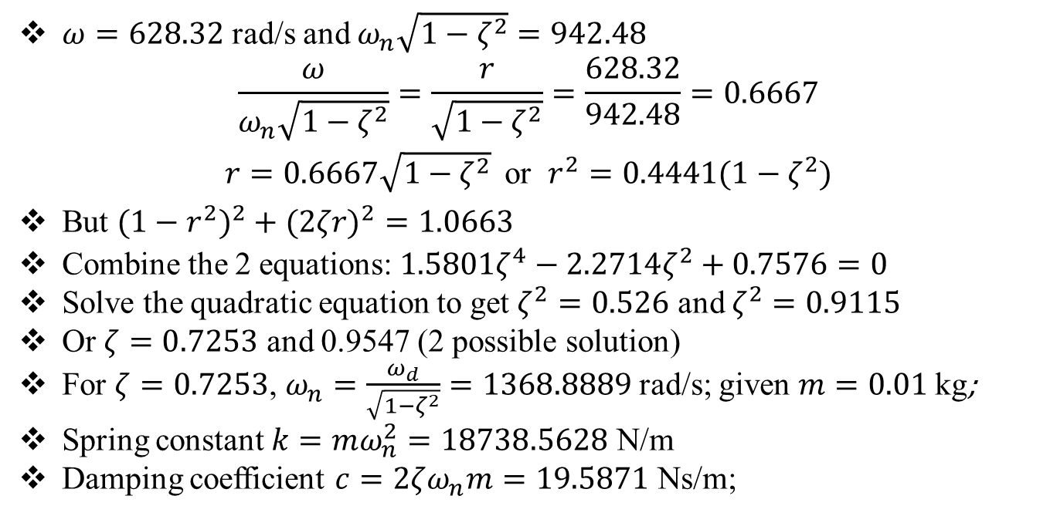
Example 3
$ω=628.32$ rad/s and $ω_{n}\sqrt{1−ζ^{2}}=942.48$
$$\frac{ω}{ω_{n}\sqrt{1−ζ^{2}}}=\frac{r}{\sqrt{1−ζ^{2}}}=\frac{628.32}{942.48}=0.6667$$
$r=0.6667\sqrt{1−ζ^{2}}$ or $r^{2}=0.4441(1−ζ^{2}$)
But $(1−r^{2})^{2}+(2ζr)^{2}=1.0663$
Combine the 2 equations: $1.5801ζ^{4}−2.2714ζ^{2}+0.7576=0$
Solve the quadratic equation to get $ζ^{2}=0.526$ and $ζ^{2}=0.9115$
Or $ζ=0.7253$ and 0.9547 (2 possible solution)
For $ζ=0.7253$, $ω_{n}=\frac{ω_{d}}{\sqrt{1−ζ^{2}}}=1368.8889$ rad/s; given $m=0.01$ kg;
Spring constant $k=mω_{n}^{2}=18738.5628$ N/m
Damping coefficient $c=2ζω_{n}m=19.5871$ Ns/m;

